Slide 1
Long Queries and the Art of Full Scan
Let’s fly Postgres Air airlines!

Slide 2

Who am I
Hettie Dombrovskaya
Database Architect at DRW Holdings, Chicago IL
Prairie Postgres NFP President
ACM Chicago Communications Chair
LPI Board of Directors Member
Illinois Prairie Postgres User Group Organizer
PG DATA Conference Organizer

Slide 3


PG DATA 2026 https://2026.pg-data.org/
CFP Open!
Early Bird Open!
Call for Sponsors Open!

Slide 4
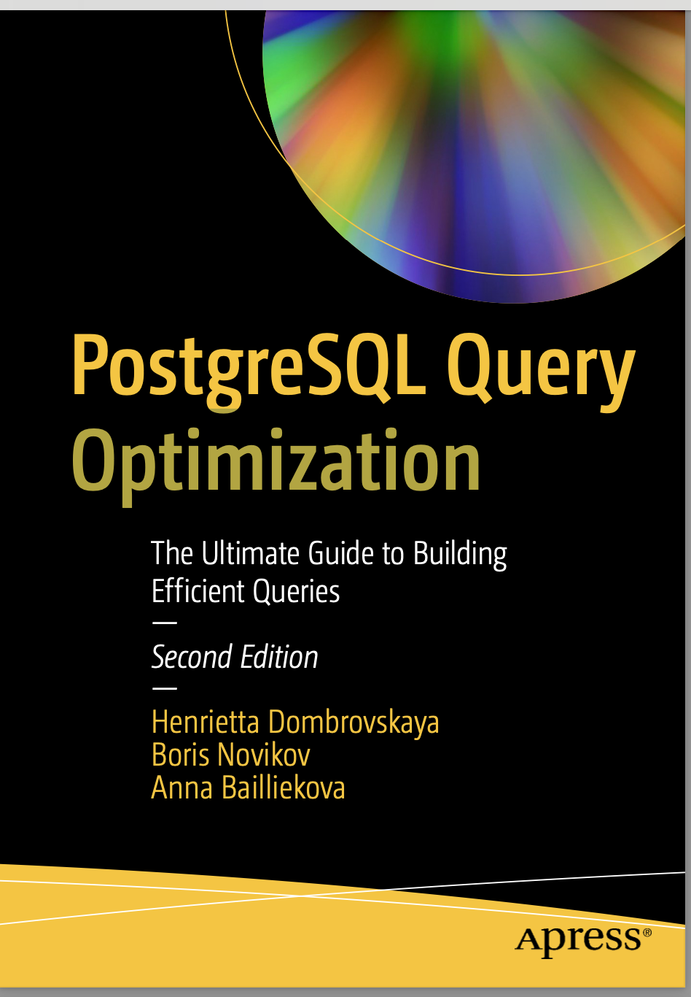

PostgreSQL Query Optimization, Apress 2024 (2nd edition)
postgres_air database:
https://github.com/hettie-d/postgres_air

Slide 5

Why this topic?
Notes:
For over thirty years, both database researchers and practitioners have maintained a clear distinction between OLTP and OLAP systems, between application databases and data warehouses.
However, this ideal picture does not match the reality of industrial practices. Often, businesses built de-facto data warehouses as parts of their real-time applications without utilizing the proper techniques. At the same time, many data warehousing and reporting commercial tools exploit the idea that business needs specialized software for efficient reporting, thus locking companies into product dependencies.

Slide 6
What is a long query?

Slide 7

Long query with long output
SELECT
d.airport_code AS
departure_airport
a.airport_code AS
arrival_airport
FROM airport a,
airport d

Slide 8

Long query with short output
SELECT avg(flight_length),
avg (passengers)
FROM
(SELECT flight_no,
scheduled_arrival -scheduled_departure AS
flight_length,
count(passenger_id) AS passengers
FROM flight f
JOIN booking_leg bl
ON bl.flight_id = f.flight_id
JOIN passenger p ON p.booking_id=bl.booking_id
GROUP BY 1,2) a

Slide 9
A query is long when the query selectivity is high: almost all rows from at least one large table contribute to the output, even is the output size is small
The notion of what is large changes

Slide 10

Can long queries be optimized?
YES
How?
Avoid multiple table scans
Make sure to reduce the size of the result at the earliest possible stage

Slide 11
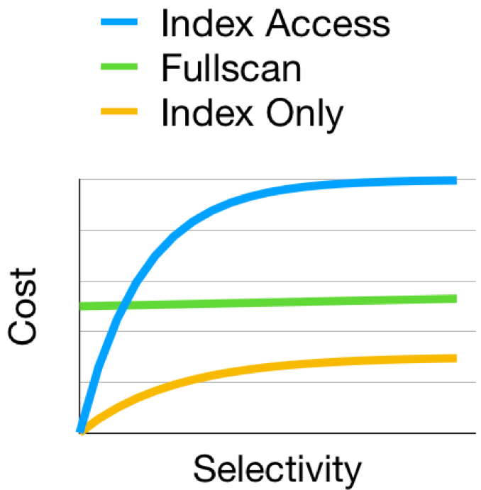
For long queries, we do not need indexes
Index scan
Full scan
Index-only scan

Slide 12
Semi-join
For long queries, the most restrictive semi-joins
should be executed first.
What is a semi-join?
A semi-join between two tables R and S returns rows from table R for which there
is at least one row from table S with matching values in the joining columns
(EXISTS with no duplicates)

Slide 13
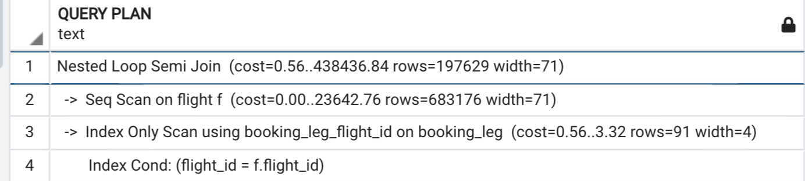
Semi-join examples
SELECT * FROM flight WHERE flight_id IN
(SELECT flight_id FROM booking_leg)
OR:
SELECT * FROM flight f WHERE EXISTS
(SELECT flight_id FROM booking_leg WHERE flight_id=f.flight_id)

Slide 14
How do we know which semi-join is the most restrictive?

Slide 15
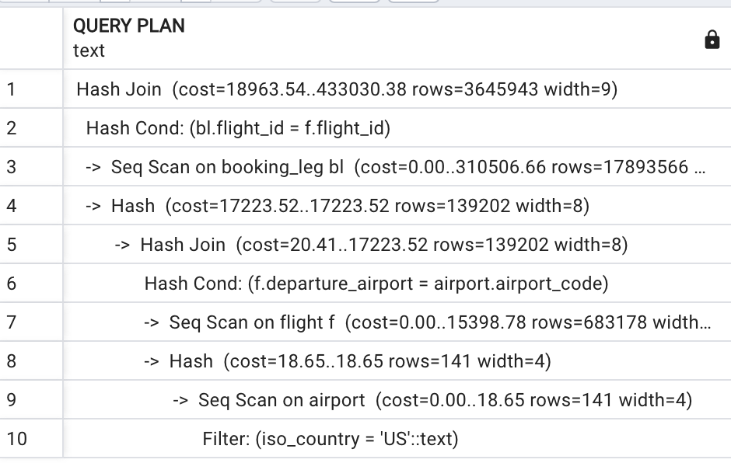
SELECT departure_airport,
booking_id,
is_returning
FROM booking_leg bl
JOIN flight f USING (flight_id)
WHERE departure_airport
IN (SELECT airport_code
FROM airport
WHERE iso_country='US’)
Notes:
No semi-join in the plan, because no duplicates to remove, but still a logical semi-join. Execution time:

Slide 16
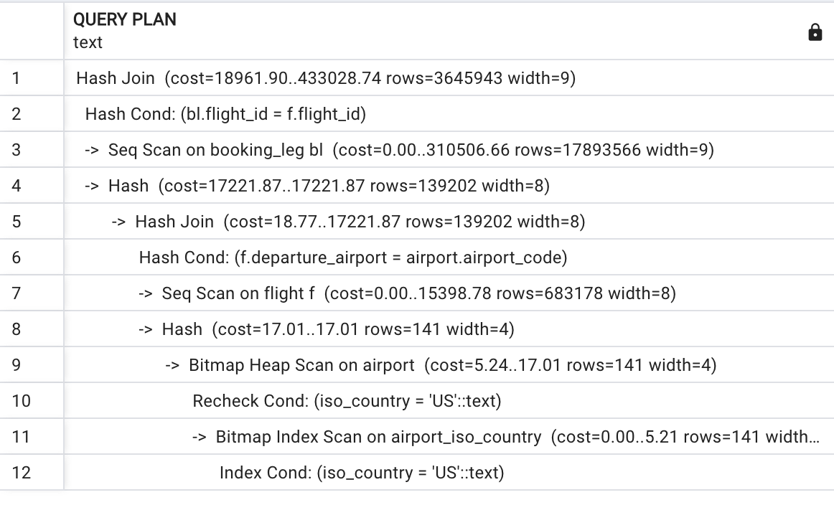
Slower, if we created an index

Slide 17
Two semi-joins: which one is more restrictive?
SELECT departure_airport, booking_id, is_returning
FROM booking_leg bl
JOIN flight f USING (flight_id)
WHERE departure_airport IN
(SELECT airport_code
FROM airport WHERE iso_country='US')
AND bl.booking_id IN
(SELECT booking_id FROM booking
WHERE update_ts>’2023-07-01')

Slide 18
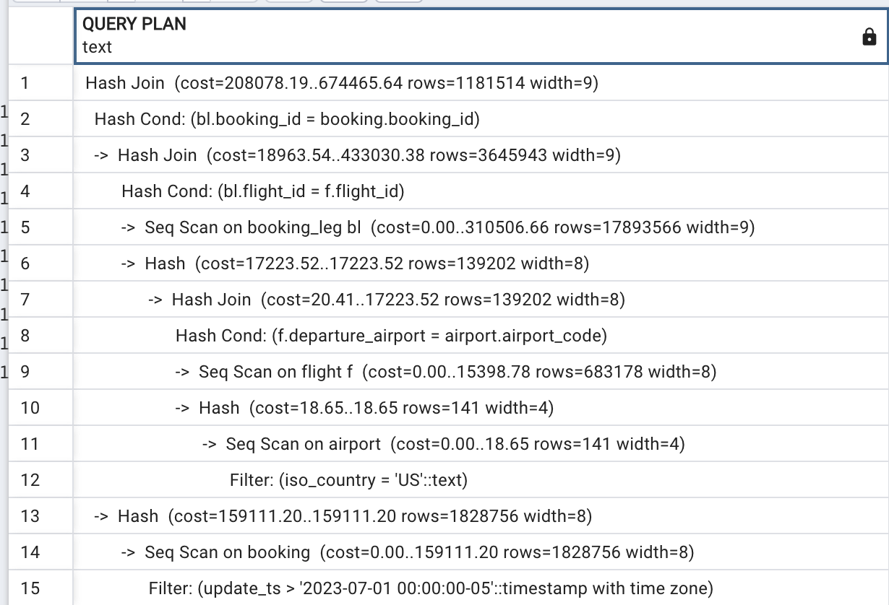

Slide 19
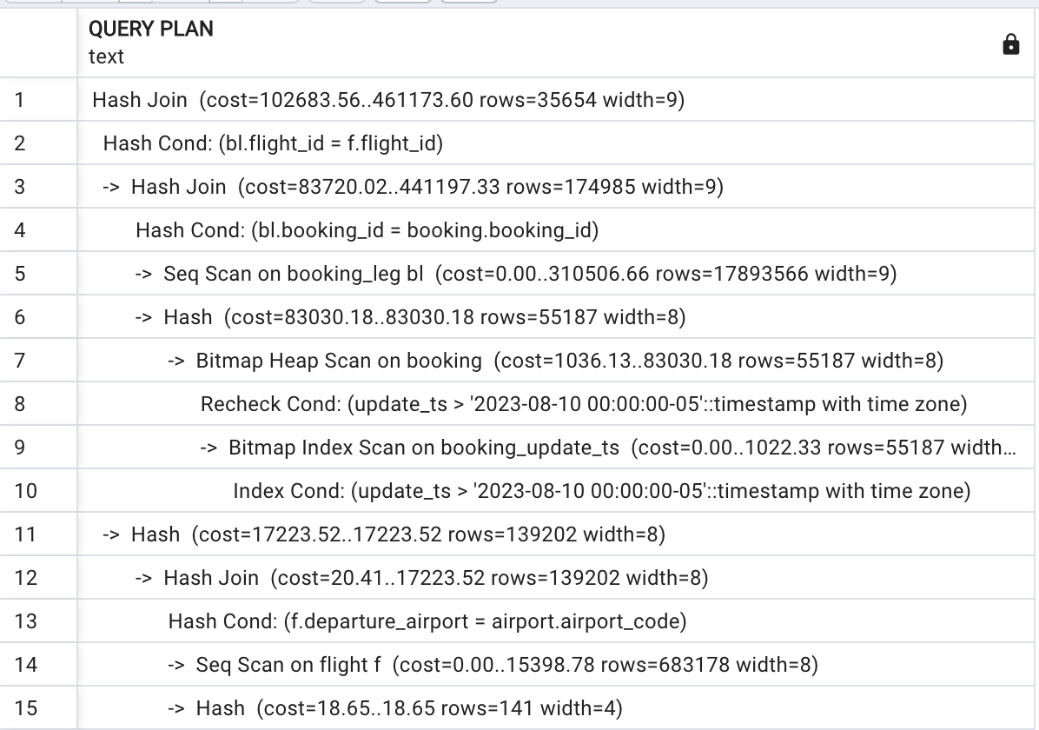
Changing update_ts condition

Slide 20
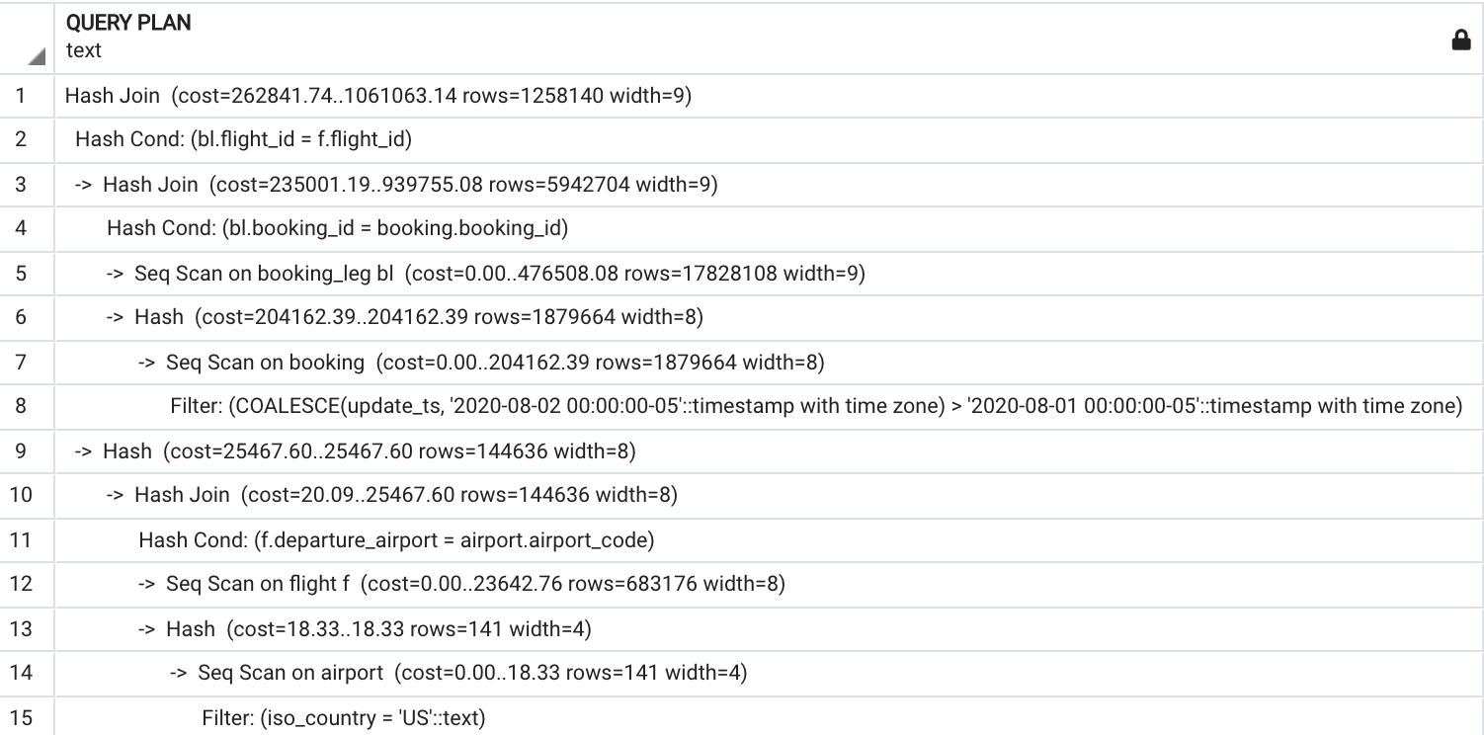
Applying column transform to block the index

Slide 21
Anti-Join
SELECT * FROM flight f WHERE NOT EXISTS
(SELECT flight_id FROM booking_leg WHERE
flight_id=f.flight_id)
SELECT * FROM flight WHERE flight_id NOT IN
(SELECT flight_id FROM booking_leg)
In PostgreSQL, only the first form guarantees Anti-Join

Slide 22
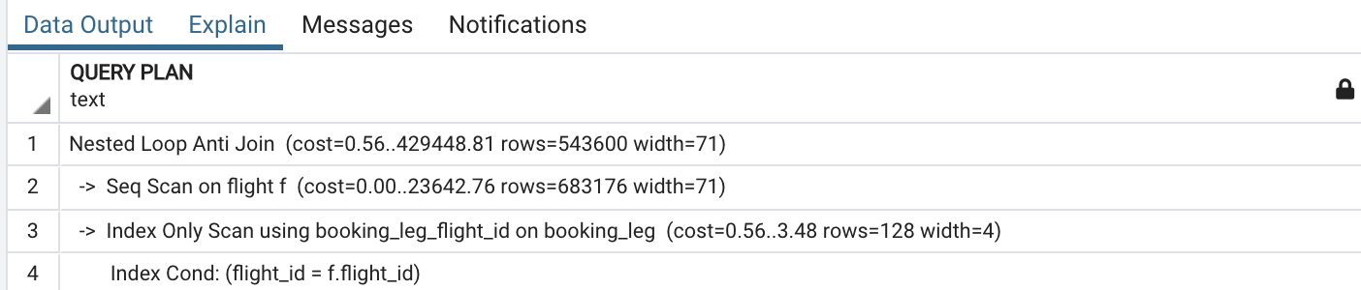
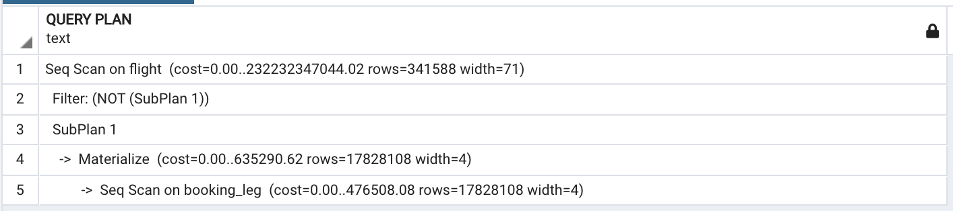

Slide 23
What if we just use JOIN?
SELECT f.*
FROM flight f
JOIN booking_leg bl USING (flight_id)
Duplicates!

Slide 24
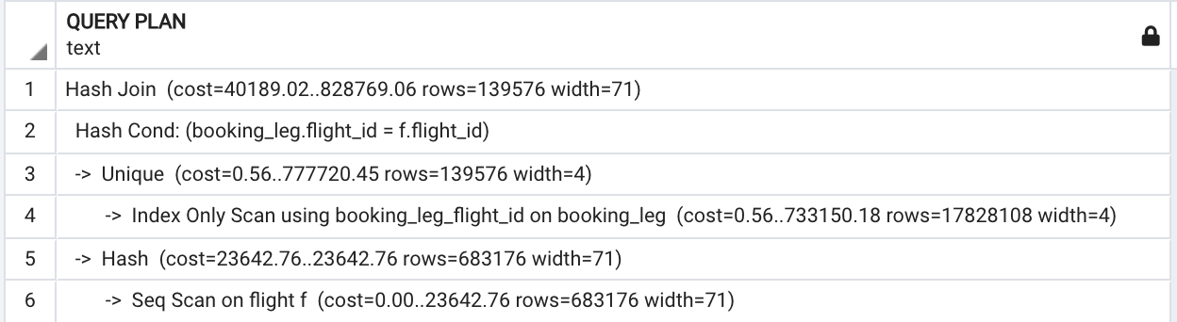
If we use DISTINCT?
SELECT *
FROM flight f
JOIN (SELECT DISTINCT flight_id FROM booking_leg) bl
USING (flight_id)
Notes:
Do you think it will be faster or slower? Twice faster!

Slide 25
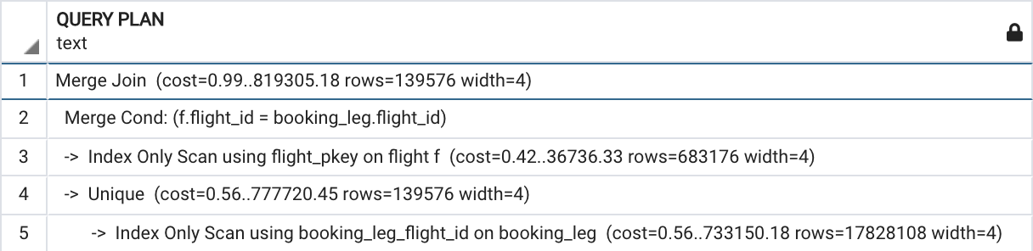
Even faster
SELECT f.flight_id
FROM flight f
JOIN (select distinct flight_id FROM booking_leg) bl USING (flight_id)

Slide 26
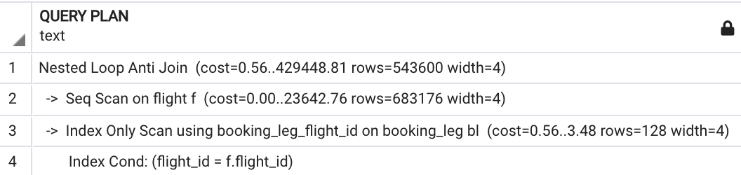
Anti-join as OUTER JOIN
(stable planner behavior)
SELECT f.flight_id
FROM flight f
LEFT OUTER JOIN booking_leg bl USING (flight_id)
WHERE bl.flight_id IS NULL

Slide 27

More on join order
Full scans are more common in OLAP systems, where the number of tables in JOIN can be massive.
What if “we know better”?

Slide 28
join_collapse_limit
By default: 8
We recommend not more than 12 but test the speed of EXPLAIN.
If N, then #of plans N!
In OLAP, it may be a good practice:
SET join_collapse_limit = 1

Slide 29

Grouping

Slide 30
Grouping example
SELECT * FROM
(SELECT bl.flight_id,
departure_airport,
(avg(price))::numeric (7,2) AS avg_price,
count(DISTINCT passenger_id) AS num_passengers
FROM booking b
JOIN booking_leg bl USING (booking_id)
JOIN flight f USING (flight_id)
JOIN passenger p USING (booking_id)
GROUP BY 1,2) a
WHERE flight_id=222183
Notes:
What do you think will happen?

Slide 31
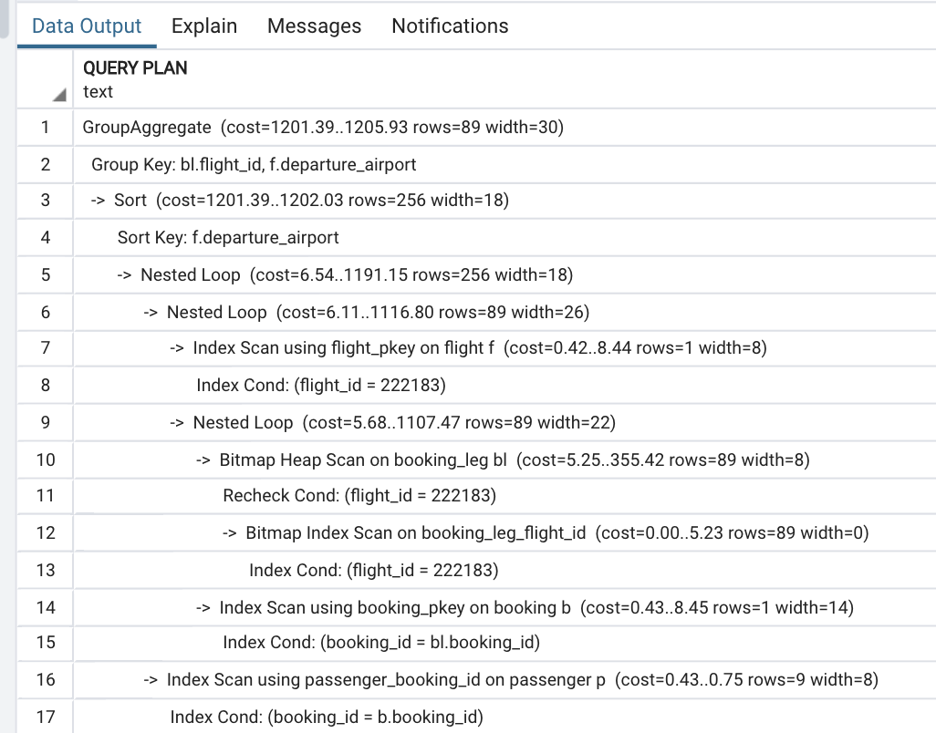
The condition is pushed inside GROUP BY

Slide 32
Will condition be pushed?
SELECT flight_id,
avg_price,
num_passengers
FROM (SELECT bl.flight_id,
departure_airport,
(avg(price))::numeric (7,2) AS avg_price,
count(DISTINCT passenger_id) AS num_passengers
FROM booking b
JOIN booking_leg bl USING (booking_id)
JOIN flight f USING (flight_id)
JOIN passenger p USING (booking_id)
GROUP BY 1,2 )a
WHERE departure_airport='ORD'

Slide 33
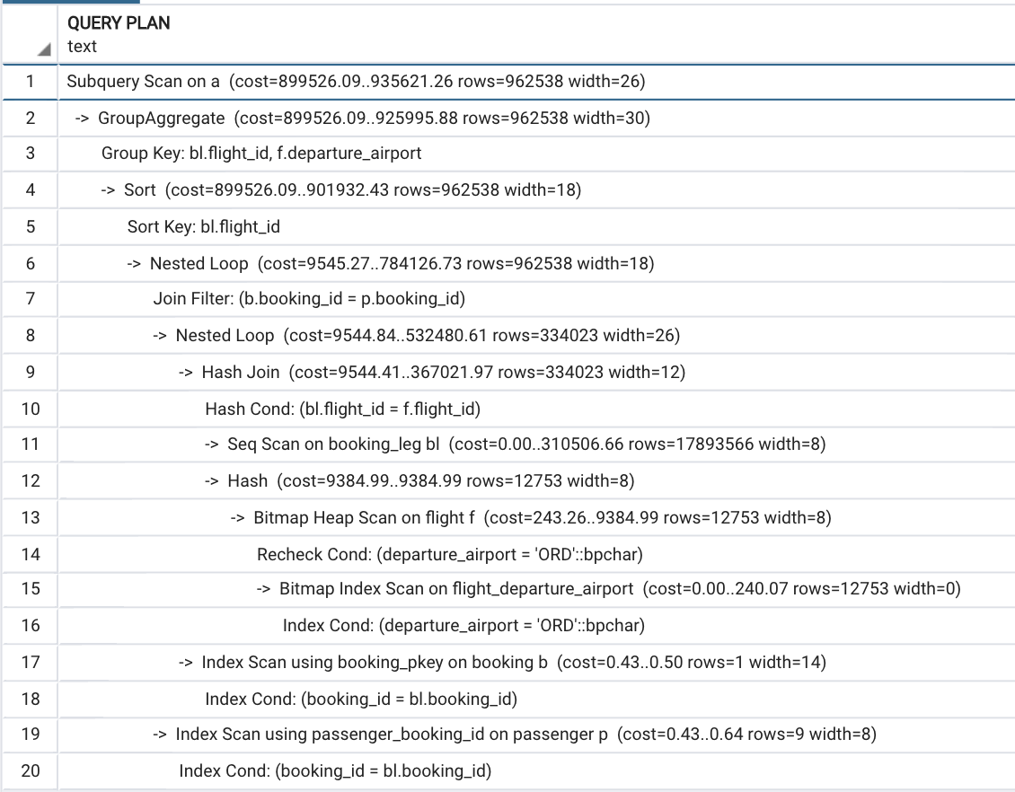

Slide 34
What about now?
SELECT a.flight_id,
a.avg_price,
a.num_passengers
FROM (SELECT bl.flight_id,
departure_airport,
(avg(price))::numeric (7,2) AS avg_price,
count(DISTINCT passenger_id) AS num_passengers
FROM booking b
JOIN booking_leg bl USING (booking_id)
JOIN flight f USING (flight_id)
JOIN passenger p USING (booking_id)
GROUP BY 1,2 ) a
WHERE flight_id in
(SELECT flight_id FROM flight WHERE scheduled_departure BETWEEN '07-03-
2023' AND '07-05-2023')

Slide 35
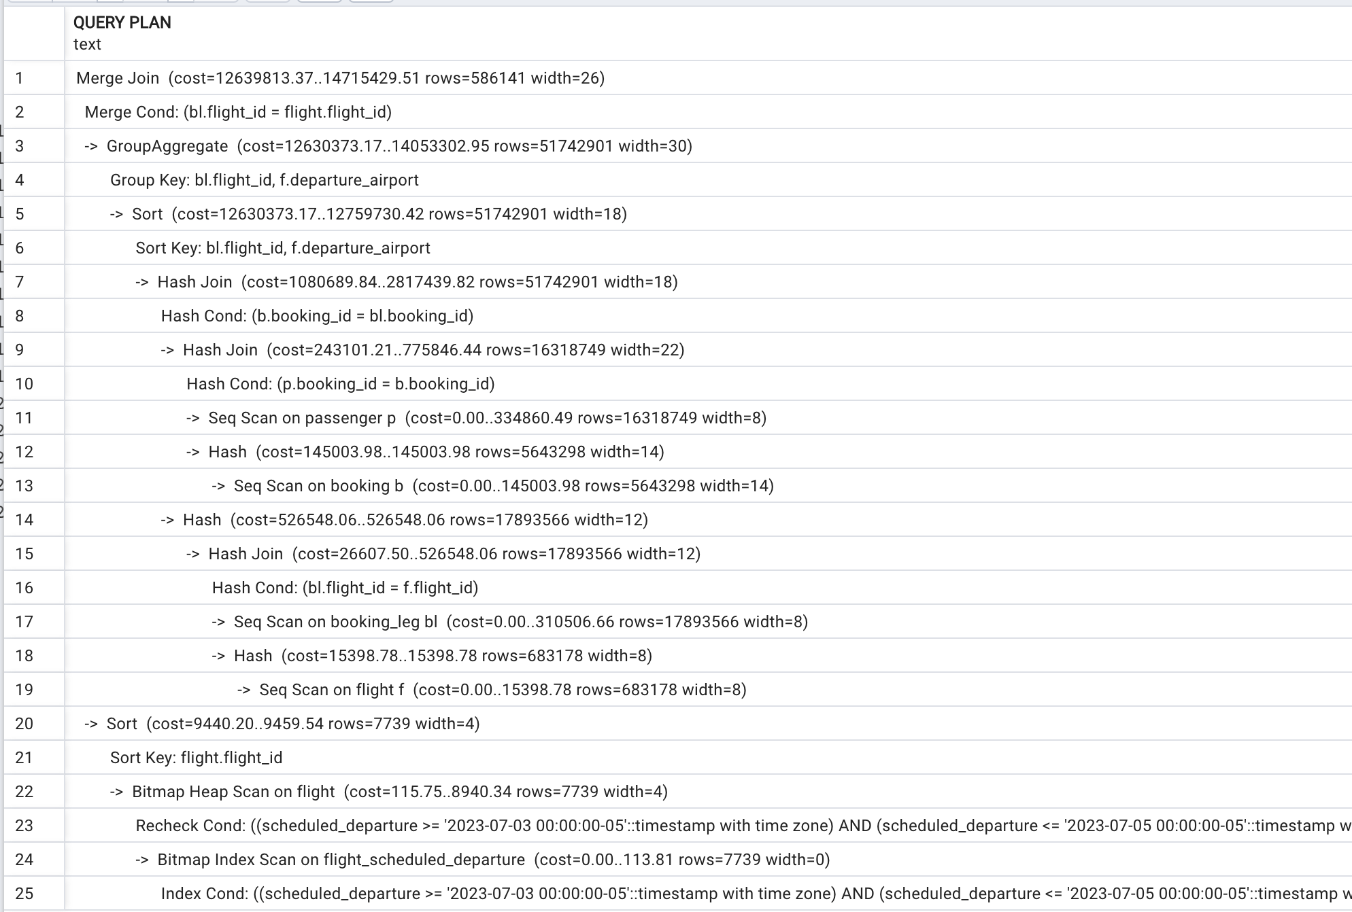

Slide 36
The previous slide is an example of pessimization –
using practices which guarantee slowing down the execution of a query.
WHY this happens?

Slide 37
Correct SELECT
SELECT bl.flight_id,
departure_airport,
(avg(price))::numeric (7,2) AS avg_price,
count(DISTINCT passenger_id) AS num_passengers
FROM booking b
JOIN booking_leg bl USING (booking_id)
JOIN flight f USING (flight_id)
JOIN passenger p USING (booking_id)
WHERE scheduled_departure
BETWEEN '07-03-2023' AND '07-05-2023'
GROUP BY 1,2

Slide 38
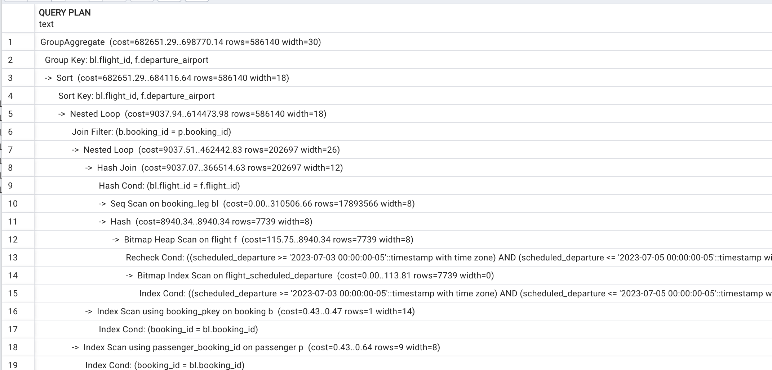

Slide 39
Group first, select Last
SELECT
city,
date_trunc('month', scheduled_departure) AS month,
count(*) passengers
FROM airport a
JOIN flight f ON airport_code = departure_airport
JOIN booking_leg l ON f.flight_id =l.flight_id
JOIN boarding_pass b ON b.booking_leg_id = l.booking_leg_id
group by 1,2
ORDER BY 3 DESC
Ex time: 7 min

Slide 40
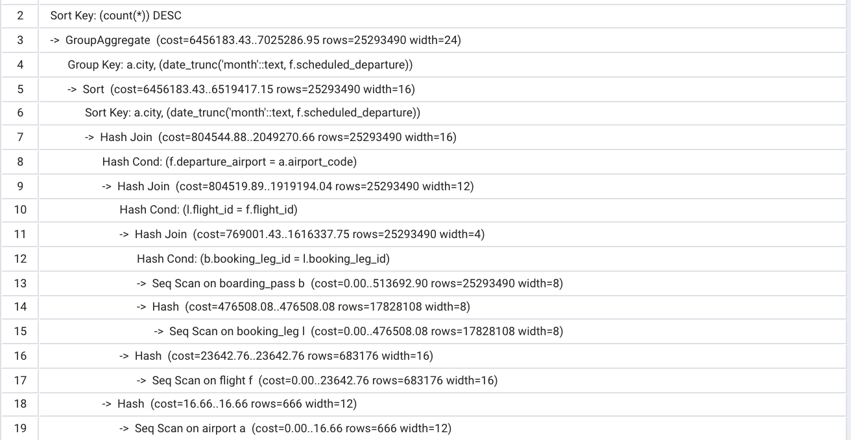

Slide 41
How can we make it better?
SELECT
city,
date_trunc('month', scheduled_departure),
sum(passengers) passengers
FROM airport a
JOIN flight f ON airport_code = departure_airport
JOIN (
SELECT flight_id, count(*) passengers
FROM booking_leg l
JOIN boarding_pass b USING (booking_leg_id)
GROUP BY flight_id
) cnt
USING (flight_id)
GROUP BY 1,2
ORDER BY 3 DESC

Slide 42
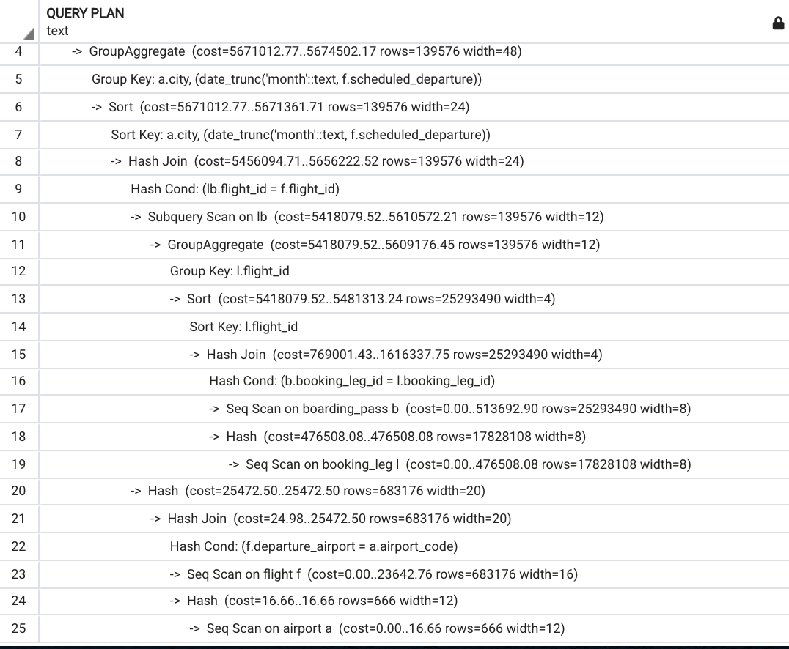

Slide 43
Execution time is 2.5 min
WHY?
Still HASH JOIN, but the data set size is smaller

Slide 44

Using SET operations
Often, we can:
• use EXCEPT instead of NOT EXISTS and NOT IN
• use INTERSECT instead of EXISTS and IN
• use UNION instead of complex selection criteria with OR

Slide 45
Example
SELECT flight_id FROM flight f
EXCEPT
SELECT flight_id FROM booking_leg
Execution time: 1 min 3 sec, almost twice faster, than anti-join

Slide 46
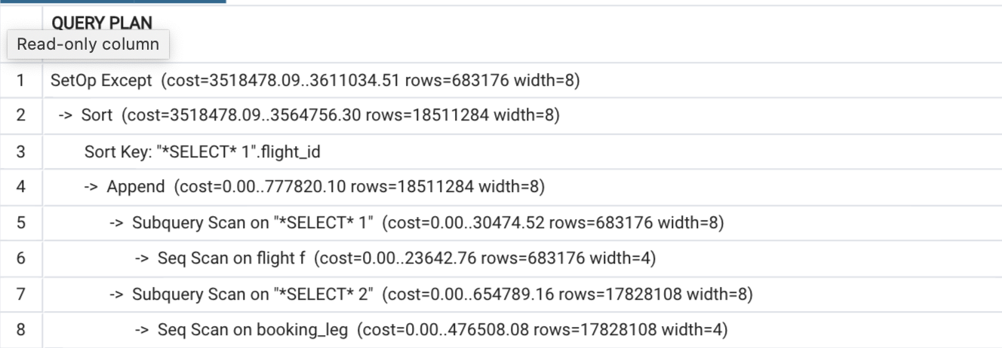

Slide 47
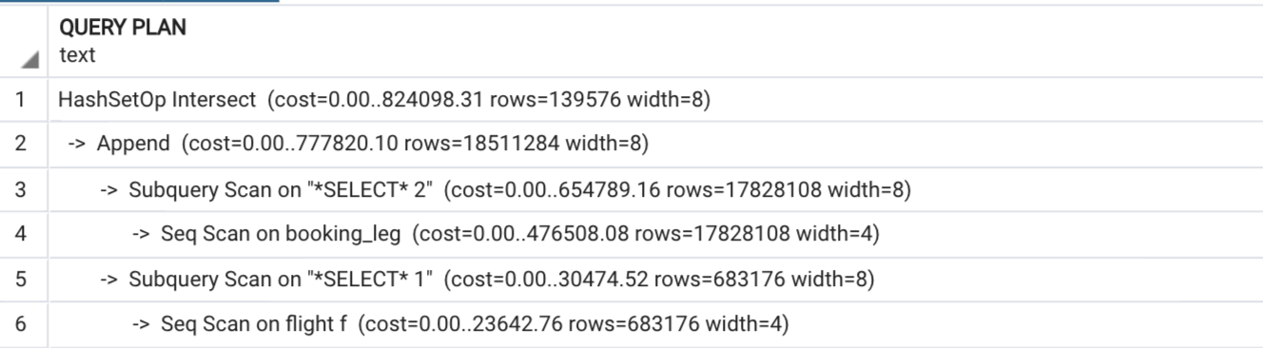
One more example
SELECT flight_id FROM flight f
INTERSECT
SELECT flight_id FROM booking_leg
Execution time: 49 sec

Slide 48

Avoiding multiple table scans
SELECT
first_name,
last_name,
pn.custom_field_value AS passport_num,
pe.custom_field_value AS passport_exp_date,
pc.custom_field_value AS passport_country
FROM passenger p
JOIN custom_field pn ON pn.passenger_id=p.passenger_id
AND pn.custom_field_name='passport_num'
JOIN custom_field pe ON pe.passenger_id=p.passenger_id
AND pe.custom_field_name='passport_exp_date'
JOIN custom_field pc ON pc.passenger_id=p.passenger_id
AND pc.custom_field_name='passport_country’
WHERE p.passenger_id<5000000

Slide 49
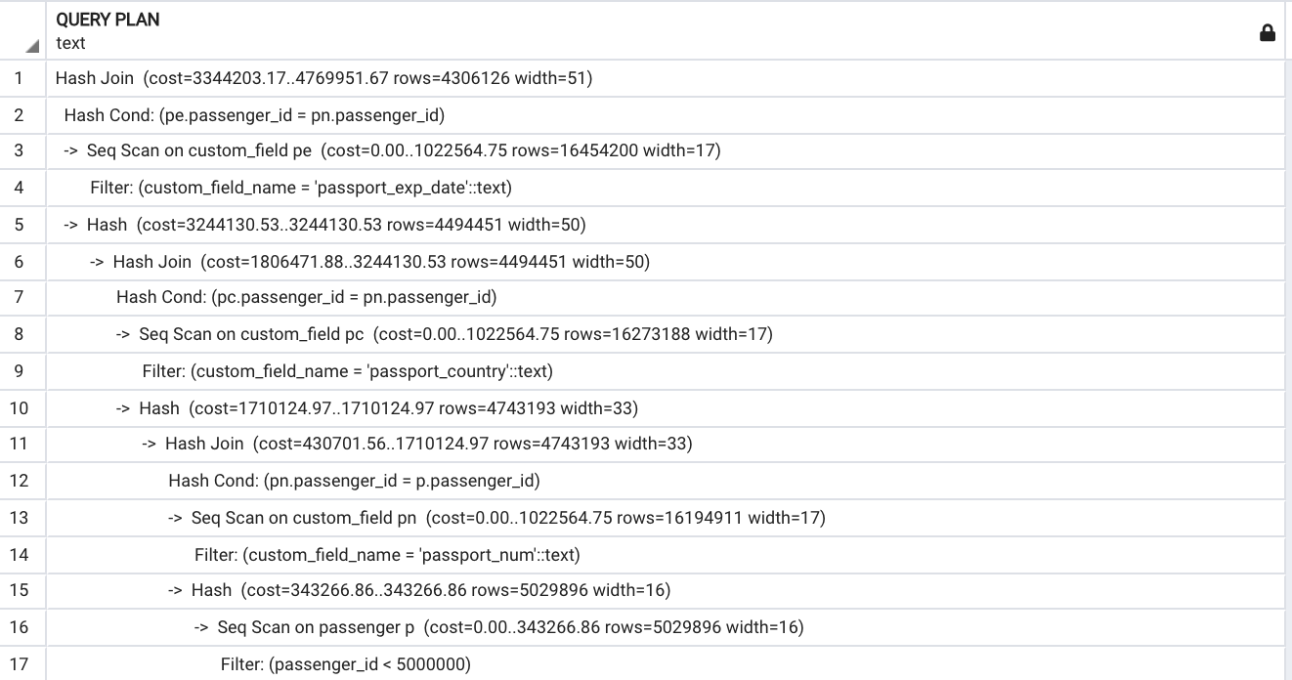

Slide 50
Correct (presumably) version
SELECT
last_name,
first_name,
coalesce(max(CASE WHEN custom_field_name ='passport_num’
THEN custom_field_value ELSE NULL END),'') AS passport_num,
coalesce(max(CASE WHEN custom_field_name='passport_exp_date’
THEN custom_field_value ELSE NULL END),'') AS passport_exp_date,
coalesce(max(CASE WHEN custom_field_name ='passport_country’
THEN custom_field_value ELSE NULL END),'') AS passport_country
FROM passenger p
JOIN custom_field cf USING (passenger_id)
WHERE cf.passenger_id<5000000
AND p.passenger_id<5000000
GROUP by 1,2

Slide 51
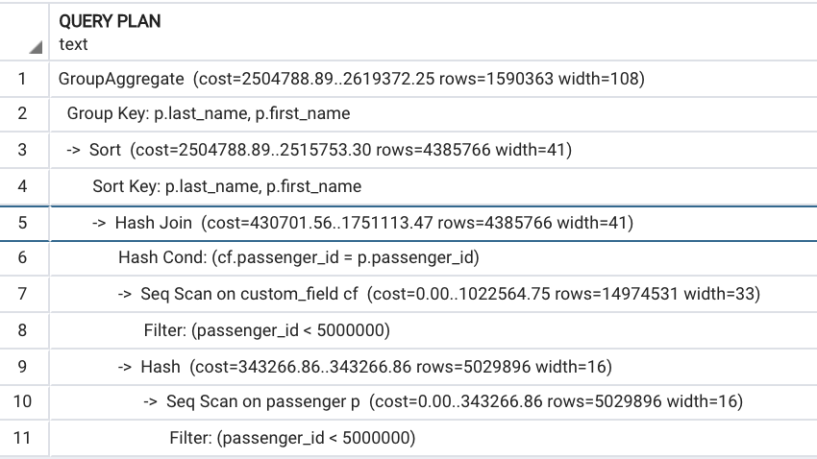

Slide 52
Why It takes longer?
It’s not only longer, but also incorrect:
there are passengers with the same first and last names

Slide 53
Correct SQL
SELECT
last_name,
first_name,
p.passenger_id,
coalesce(max(CASE WHEN custom_field_name ='passport_num’
THEN custom_field_value ELSE NULL END),'') AS passport_num,
coalesce(max(CASE WHEN custom_field_name='passport_exp_date’
THEN custom_field_value ELSE NULL END),'') AS passport_exp_date,
coalesce(max(CASE WHEN custom_field_name ='passport_country’
THEN custom_field_value ELSE NULL END),'') AS passport_country
FROM passenger p
JOIN custom_field cf USING (passenger_id)
WHERE cf.passenger_id<5000000
AND p.passenger_id<5000000
GROUP by 3,1,2

Slide 54
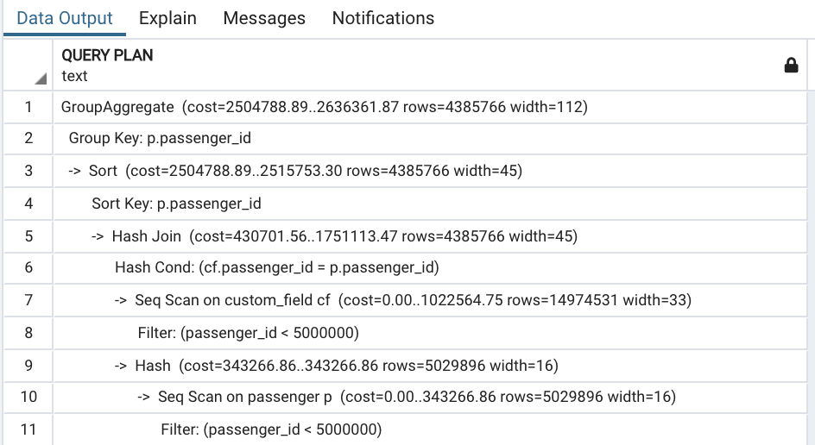

Slide 55

Let’s perform one more optimization:
Reduce the size of the intermediate result set

Slide 56
Even better SQL
SELECT last_name,
first_name,
passport_num,
passport_exp_date,
passport_country
FROM passenger p
JOIN (SELECT
cf.passenger_id,
coalesce(max(CASE WHEN custom_field_name ='passport_num’
THEN custom_field_value ELSE NULL END),'') AS passport_num,
coalesce(max(CASE WHEN custom_field_name='passport_exp_date’
THEN custom_field_value ELSE NULL END),'') AS passport_exp_date,
coalesce(max(CASE WHEN custom_field_name ='passport_country’
THEN custom_field_value ELSE NULL END),'') AS passport_country
FROM custom_field cf
WHERE cf.passenger_id<5000000
GROUP BY 1) info
USING (passenger_id)
WHERE p.passenger_id<5000000

Slide 57
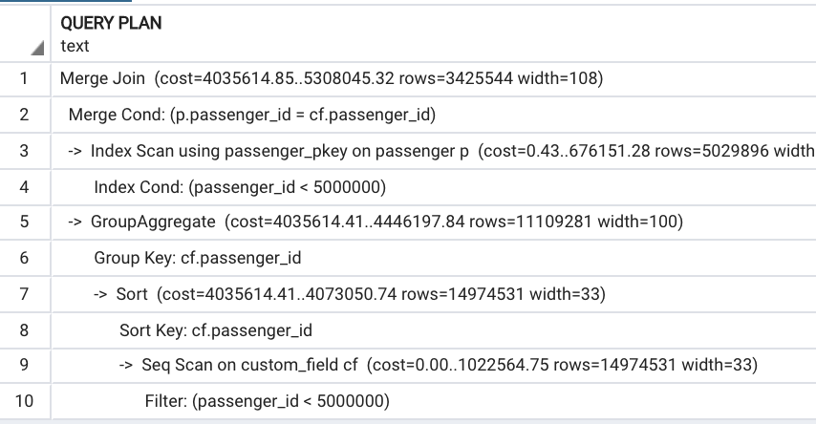

Slide 58
Summary
Optimization goal: to reduce the size of the intermediate data sets.
Techniques:
  Control join order
  Use semi and anti joins
  Filtering before grouping
  OR grouping before filtering
  Using SET operations
  Avoiding multiple table scans

Slide 59




LinkedIn:
Prairie Postgres
prairiepostgres.org
GitHub:
https://github.com/hettie-d
PG DATA 2026
2026.pg-data.org

Slide 60


Q&A Time!
Feedback!

